Slide 1


PREDICTING KIDNEY CANCER SURVIVAL FROM GENOMIC DATA
UNIVERSITY WITH A PURPOSE
Presented By:
Kartik Tyagi (R100218024)
Divyanshu Sharma (R142218026)
Sahil Sangwan (R100218050)
Shubham Patel (R100216088)
Parixit Tomar (R164218104)
Mentor :
Mr. Abhijit Kumar

Slide 2
PROBLEM STATEMENT
To build a project using machine learning concepts, and genomic data which can help in predicting kidney cancer survival.

Slide 3
PREDICTING KIDENY CANCER SURVIVAL USING GENOMIC DATA

Slide 4
KIDNEY CANCER

Slide 5
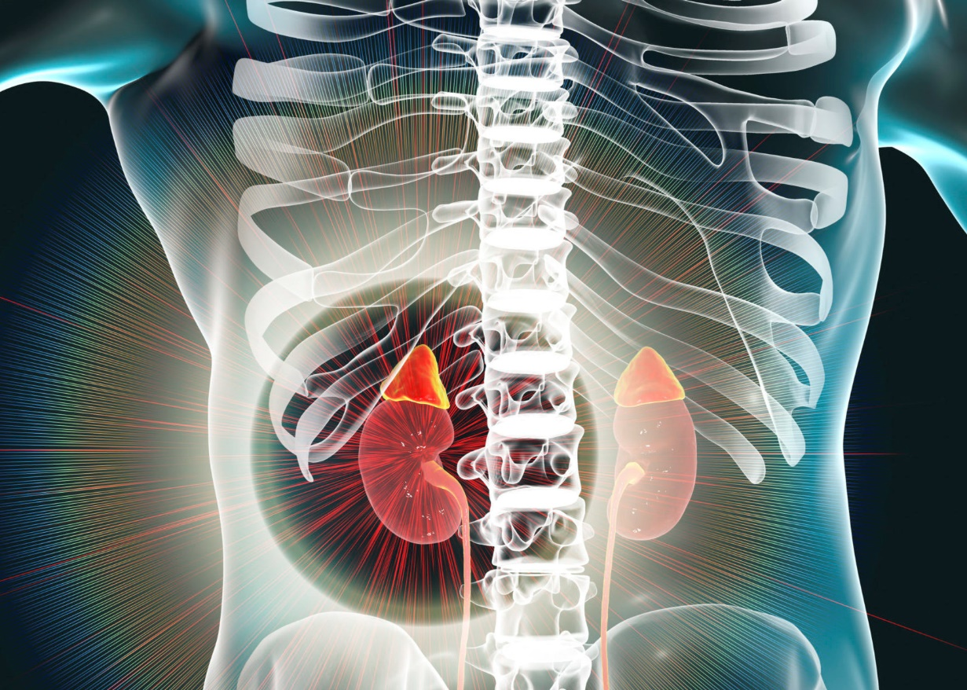
What is kidney cancer?
Kidney cancer, also called RENAL CANCER, is a disease in which kidney cells become malignant (cancerous) and grow out of control.

Slide 6
GENOMIC DATA

Slide 7
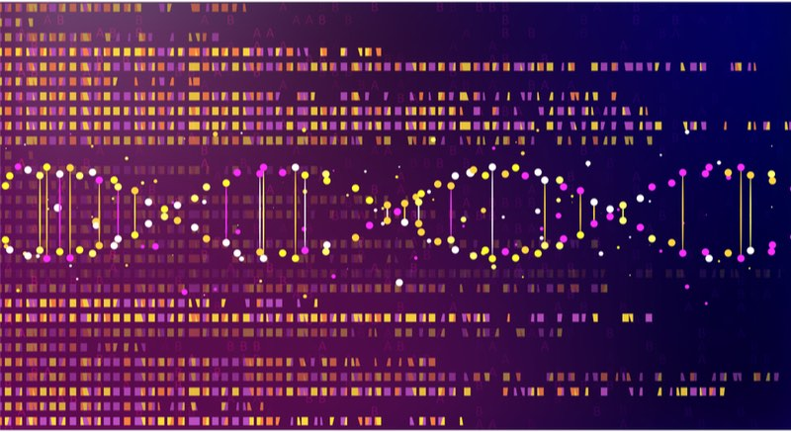
What is genomic data?
Genomic data refers to the genome and DNA data of an organism. They are used in bioinformatics for collecting, storing and processing the genomes of living things. Genomic data generally require a large amount of storage and purpose-built software to analyze.

Slide 8


How to predict kidney cancer survival using genomic data?
RNA Seq. Data
Clinical Data
Labelled Subtype miRNA data
Matching Case ID, miRNA files and subtype label
miRNA quantitative data
Subtype Information

Slide 9
DESIGN, ARCHITECTURE, IMPLEMENTATION
& TESTING

Slide 10
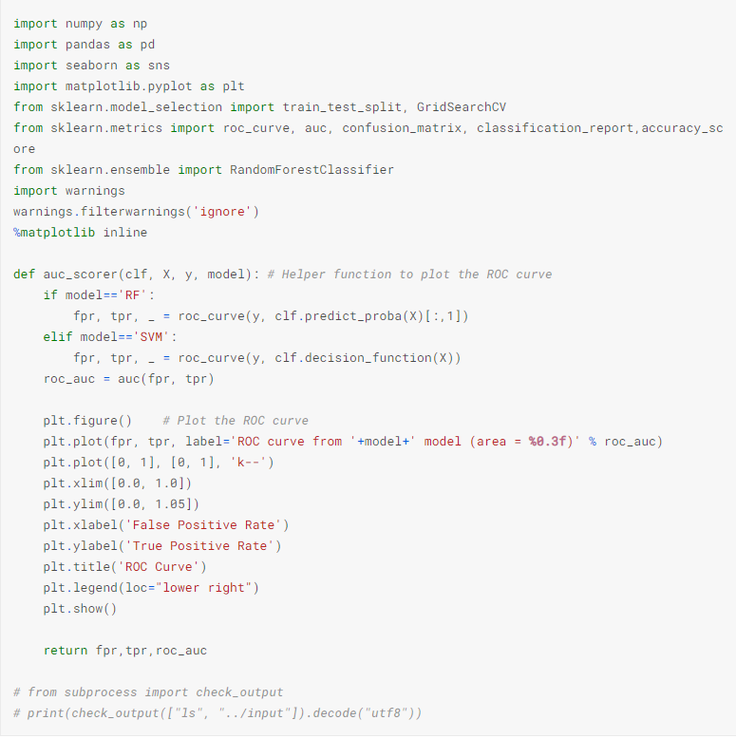
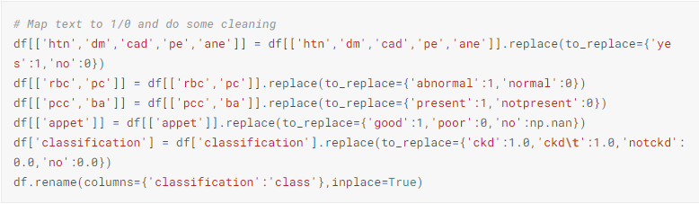
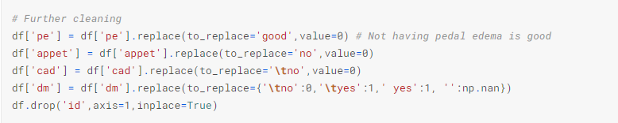
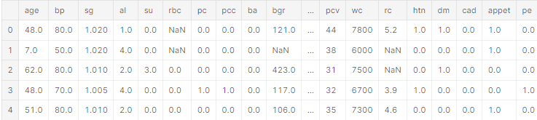
Modules and helper functions
Loading Files
Cleaning and Pre-processing of Data for Training a Classifier

Slide 11
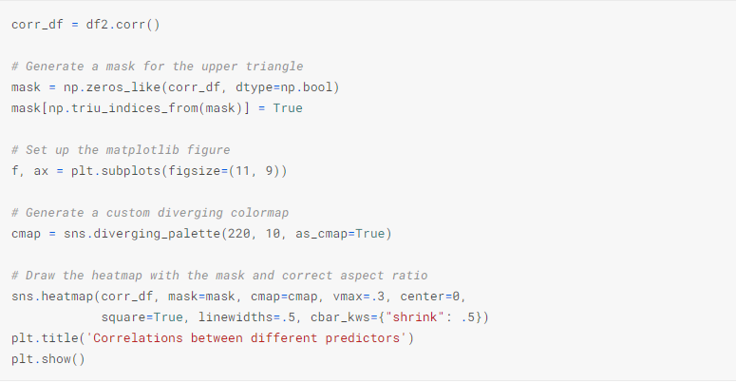
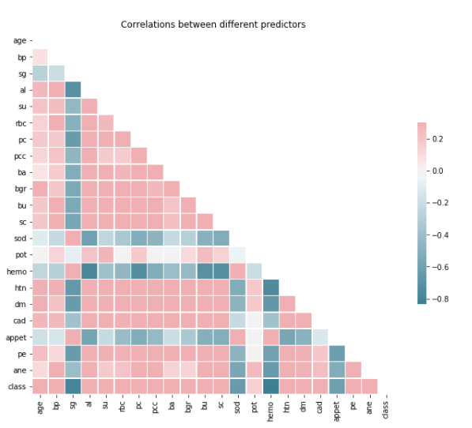
Correlation between different parameters.
Correlation
Code snippet

Slide 12
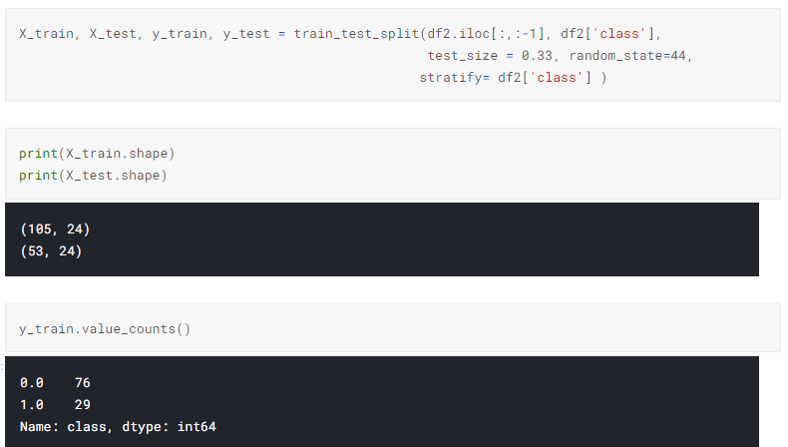
Splitting the Set for Training Models further into a (sub-)training set and testing set

Slide 13
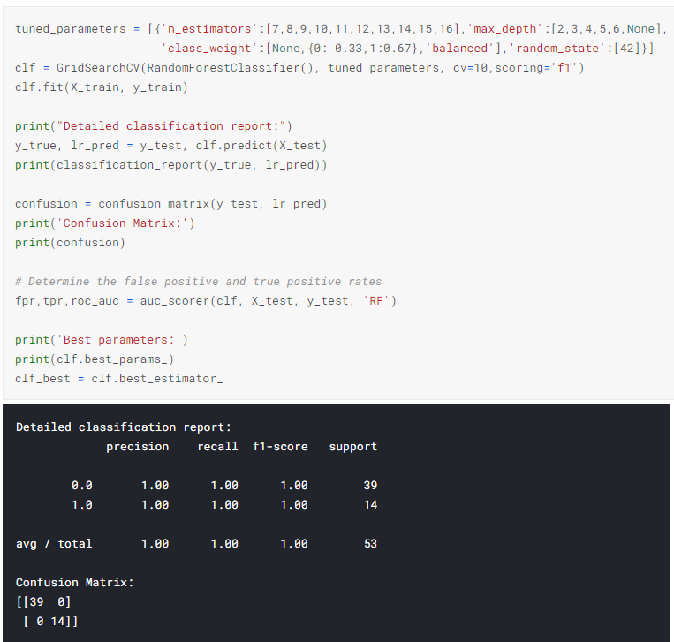
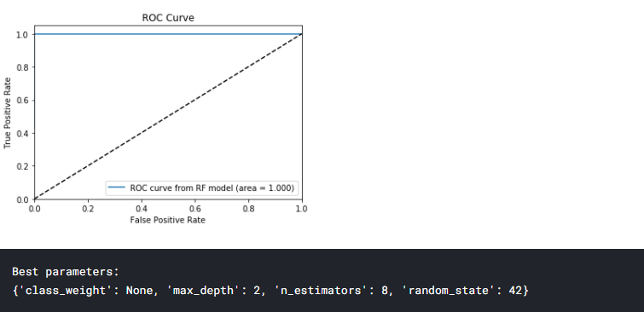
Choosing parameters with GridSearchCV with 10-fold cross validations.

Slide 14
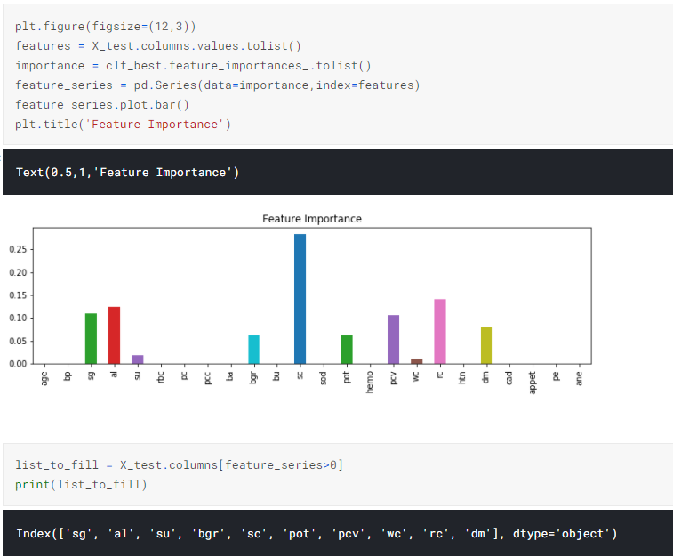
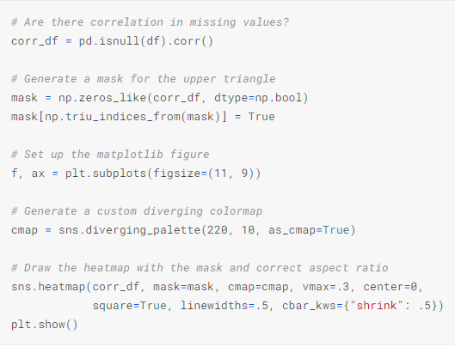
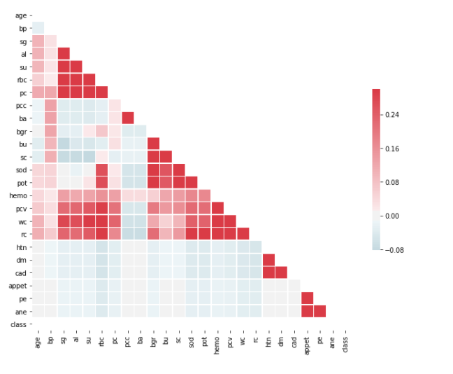
Examine feature importance
Examining the rest of the dataset

Slide 15
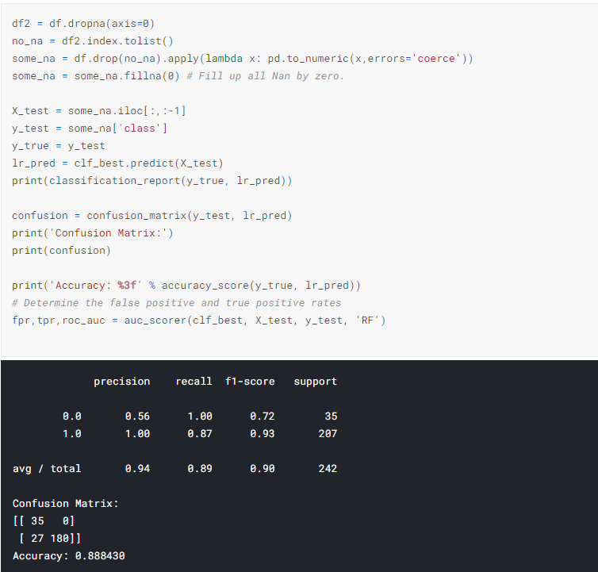
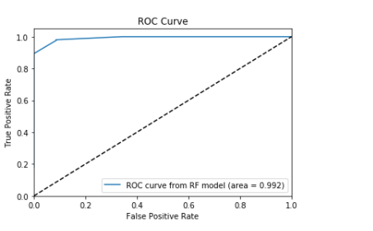
Making predictions with the best model selected above:
True positive = 180
True negative = 35
False positive = 0
False negative = 27
Accuracy = 88.8%
ROC AUC = 99.2%

Slide 16
Advantages, and Disadvantages
High Detection Accuracy
Low false positive rate
Requires more amount of data for more perfection

Slide 17
OBJECTIVE ACHIEVED Building project for predicting kidney cancer survival using genomic data.
31-07-2021

Slide 18
SCOPE OF IMPROVEMENT
If the datasets are collected from all over the world and more patients chances of predicting the rate of survival will increase.

Slide 19
REFERENCES
Villarroel, Maria Central. ” Personalizing cancer treatment in the age of global genomic analyses: PALB2 gene mutations and the response to DNA damaging agents in pan- cretic cancer.” Molecular cancer therapeutics 10.1 (2011): 3-8.
Chow W-H, Dong LM, Devesa SS. Epidemiology and risk factors for kidney cancer. Nature reviews. Urology 2010;7(5):245-257: 10.1038/nrurol.2010.46.
Pirooznia M, Yang JY, Yang MQ, Deng Y. A comparative study of different machine learning methods on microarray gene expression data. BMC Genomics. 2008;9 Suppl 1:S13.
Loeb LA, Loeb KR, Anderson JP. Multiple mutations and cancer. Proc Natl Acad Sci USA. 2003;100(3):776-81.
Nowell PC. The clonal evolution of tumor cell populations. Science. 1976;194(4260):23-28.
The results shown here are in whole or part based upon data generated by the TCGA Research Network: http://cancergenome.nih.gov/.
Cancer Genome Atlas Network. ” Comprehensive molecular portraits of human breast tumors.” Nature 490.7418 (2012): 61-70.
Gross, Andrew Metal. ”Multi-tiered genomic analysis of head and neck cancer ties TP53 mutation to 3p loss.” Nature genetics (2014).
Rossi, Davide, Metal. ” Mutations of NOTCH1 are an in- dependent predictor of survival in chronic lymphocytic leukemia.” Blood 119.2 (2012): 521-529.

Slide 20
Thank You!!!

